Slide 1
Hypervisor and Virtual machine

Slide 2
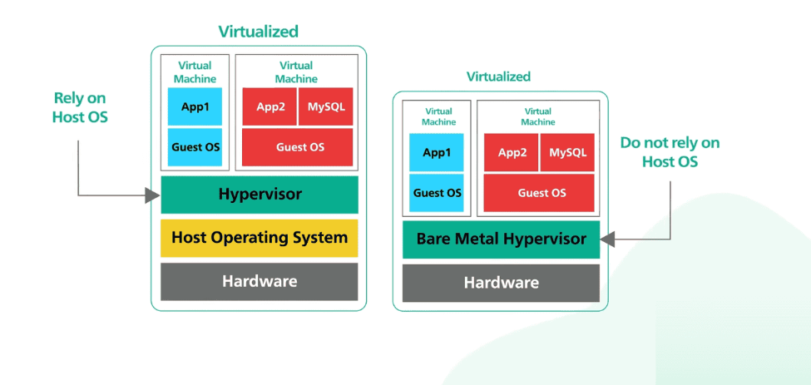

Slide 3
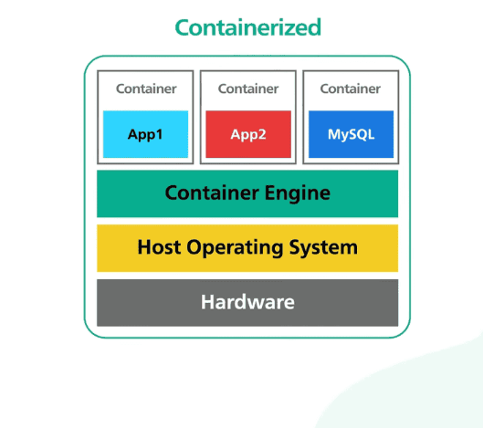

Slide 4
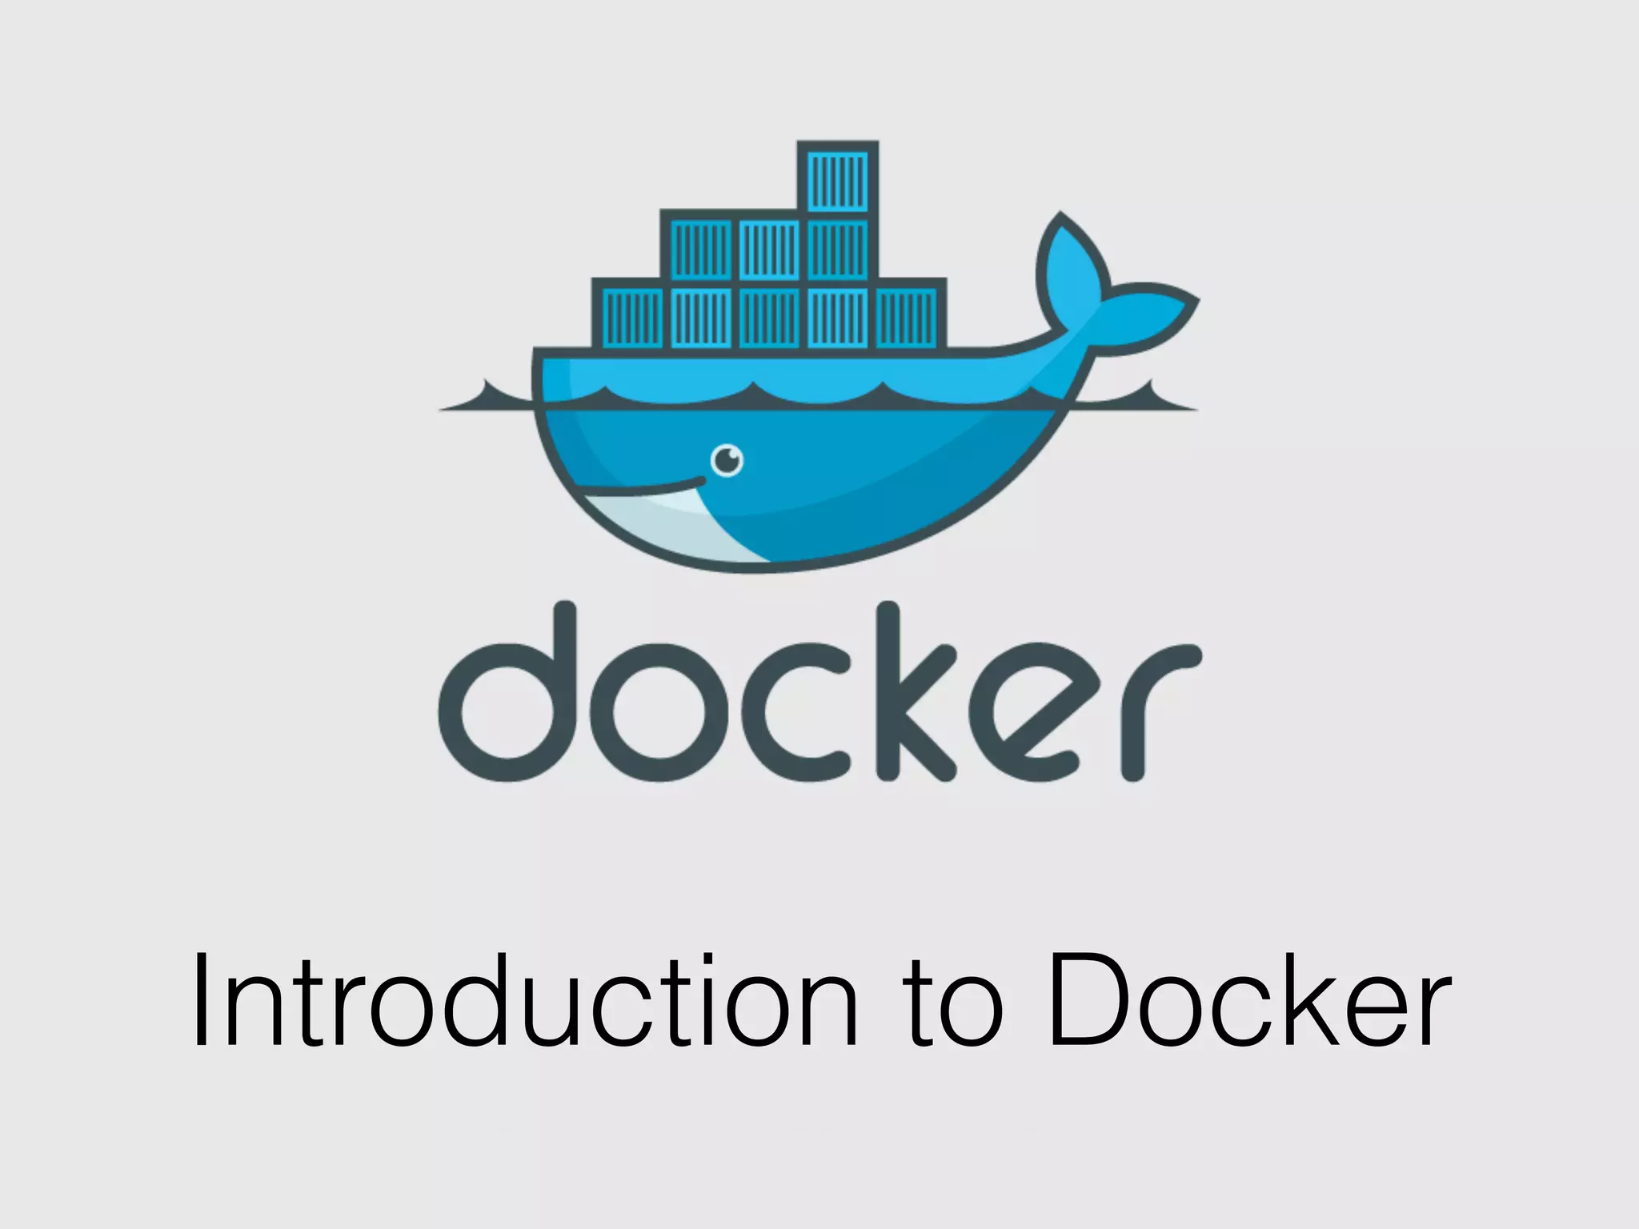

Slide 5
Docker Engine
Docker Daemon
Docker CLI(Command line interface)

Slide 6
Docker Daemon
Build Images
Run and manage containers
Runs in background and controls all docker function.

Slide 7
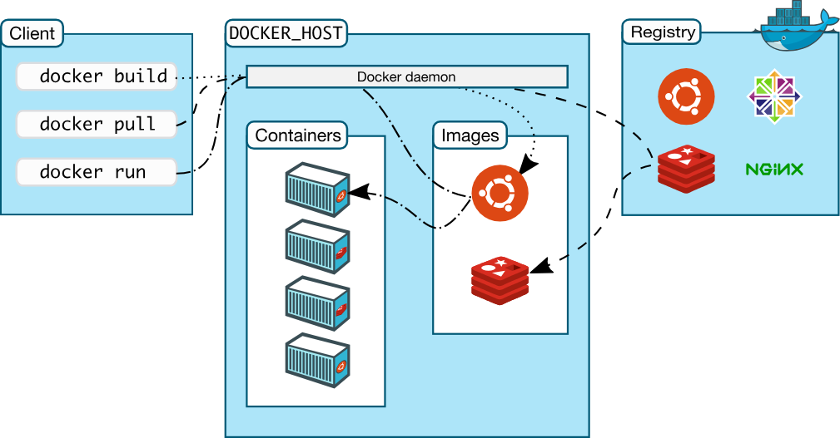

Slide 8
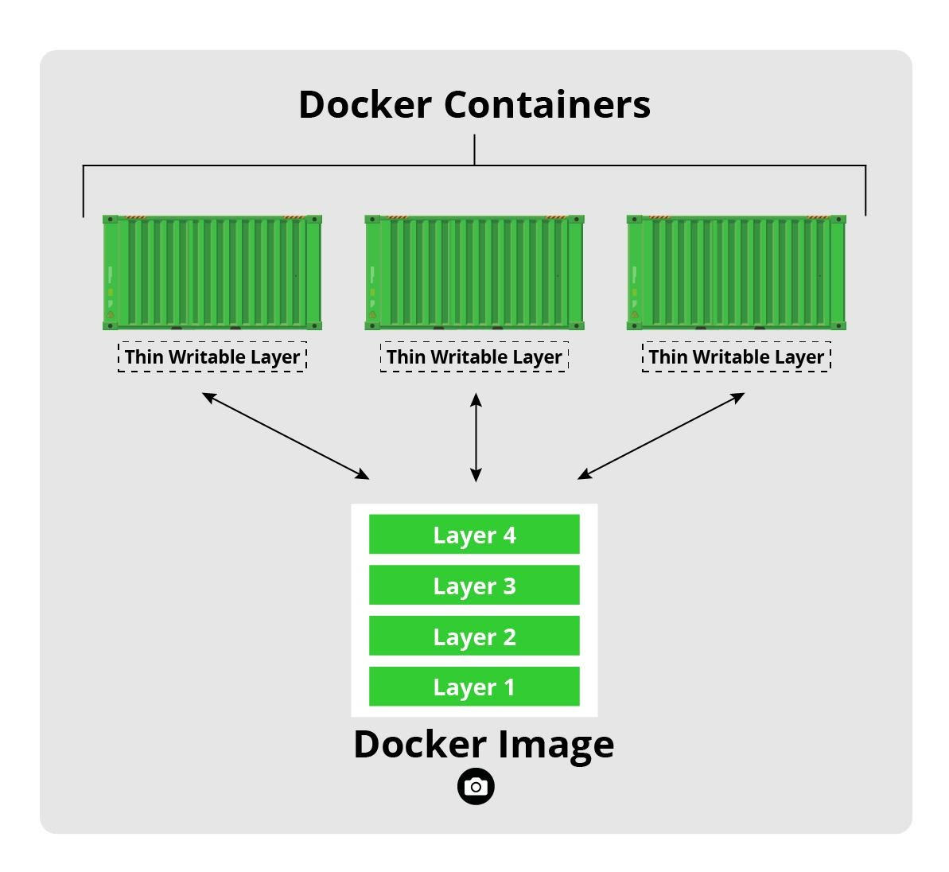

Slide 9
Why Docker Volumes?
Docker volumes are the preferred way to save data over restarts of a Docker container. When compared to bind mounts, here are some of advantages of volumes:
Volumes are easier to back up and migrate.
Managing volumes can done from the Docker CLI.
They work on Linux and Windows.
Volumes are safer to share among containers.
Volume drivers allow volumes to be stored on remote hosts or cloud providers.
New volumes can be pre-populated by the container.
Volumes do not increase the size of the container.

Slide 10
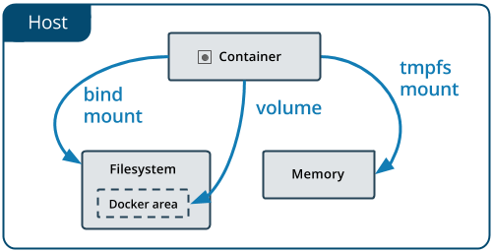
Types of volume

Slide 11
Docker Network
Container networking refers to the ability for containers to connect to and communicate with each other, or to non-Docker workloads.

Slide 12
Docker Network driver
Bridge – Bridge like network to connect multiple containers together (Default network type in docker)
Host – to publish container to host network
Overlay – used for docker swarm
Ipvlan – to give ip address to container
Macvlan – to give mac address to container
none

Slide 13
Docker compose
Compose is a tool for defining and running multi-container Docker applications. With Compose, you use a YAML file to configure your application's services. Then, with a single command, you create and start all the services from your configuration.
Compose works in all environments; production, staging, development, testing, as well as CI workflows.

Slide 14
